Slide 1
Practicing Inference
Dr. Ab Mosca (they/them)
Slides based off slides courtesy of OpenIntro and John McGreedy of Johns Hopkins University

Slide 2
Plan for Today
Have some fun
Recap Inference for Proportions
Recap Inference for Means

Slide 3
So far…
Hypothesis test for a difference between a sample proportion and a population proportion
What are the parameters of interest?
What are the conditions?
What is the test statistic?
Hypothesis test for a difference between two proportions
What are the parameters of interest?
What are the conditions?
What is the test statistic?

Slide 4
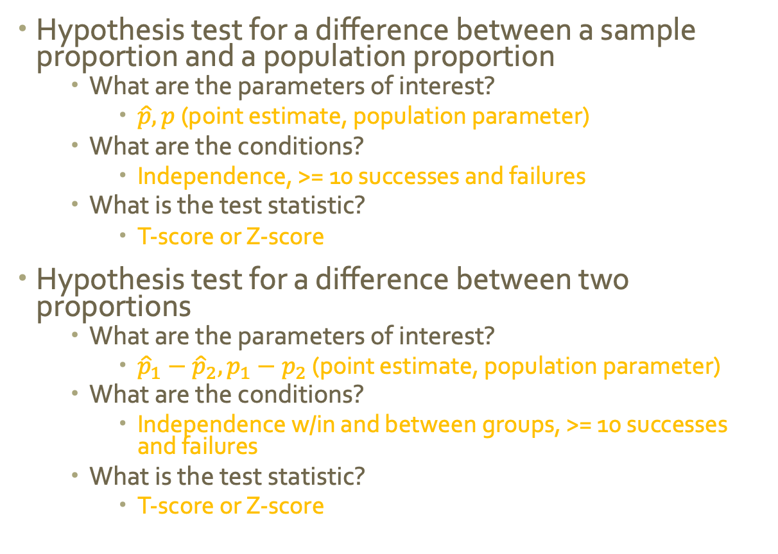
So far…
Hypothesis test for a difference between a sample proportion and a population proportion
What are the parameters of interest?
$\hat{p}, p$ (point estimate, population parameter)
What are the conditions?
Independence, >= 10 successes and failures
What is the test statistic?
T-score or Z-score
Hypothesis test for a difference between two proportions
What are the parameters of interest?
${\hat{p}}_{1}−{\hat{p}}_{2}, p_{1}−p_{2}$ (point estimate, population parameter)
What are the conditions?
Independence w/in and between groups, >= 10 successes and failures
What is the test statistic?
T-score or Z-score

Slide 5



Hand Turkey Time

Slide 6
Practice Time
The national proportion of left-handed people is 10%. Is the proportion of left-handed people in this class significantly different than the national proportion?

Slide 7
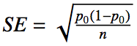
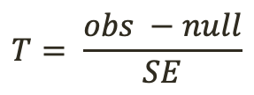
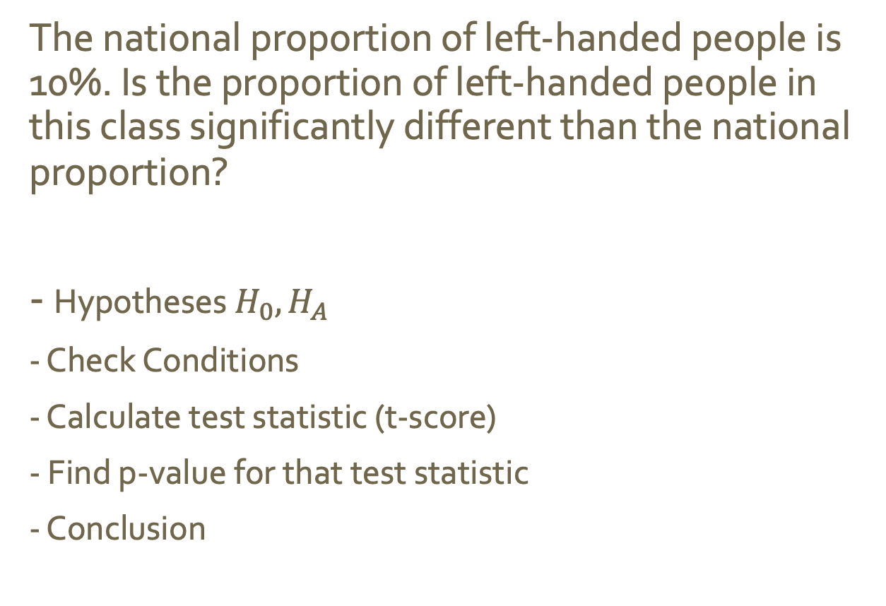
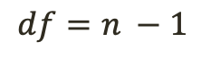
Practice Time
The national proportion of left-handed people is 10%. Is the proportion of left-handed people in this class significantly different than the national proportion?
- Hypotheses $H_{0}, H_{A}$
- Check Conditions
- Calculate test statistic (t-score)
- Find p-value for that test statistic
- Conclusion
$$T= \frac{obs −null}{SE}$$
$$df=n −1$$

Slide 8
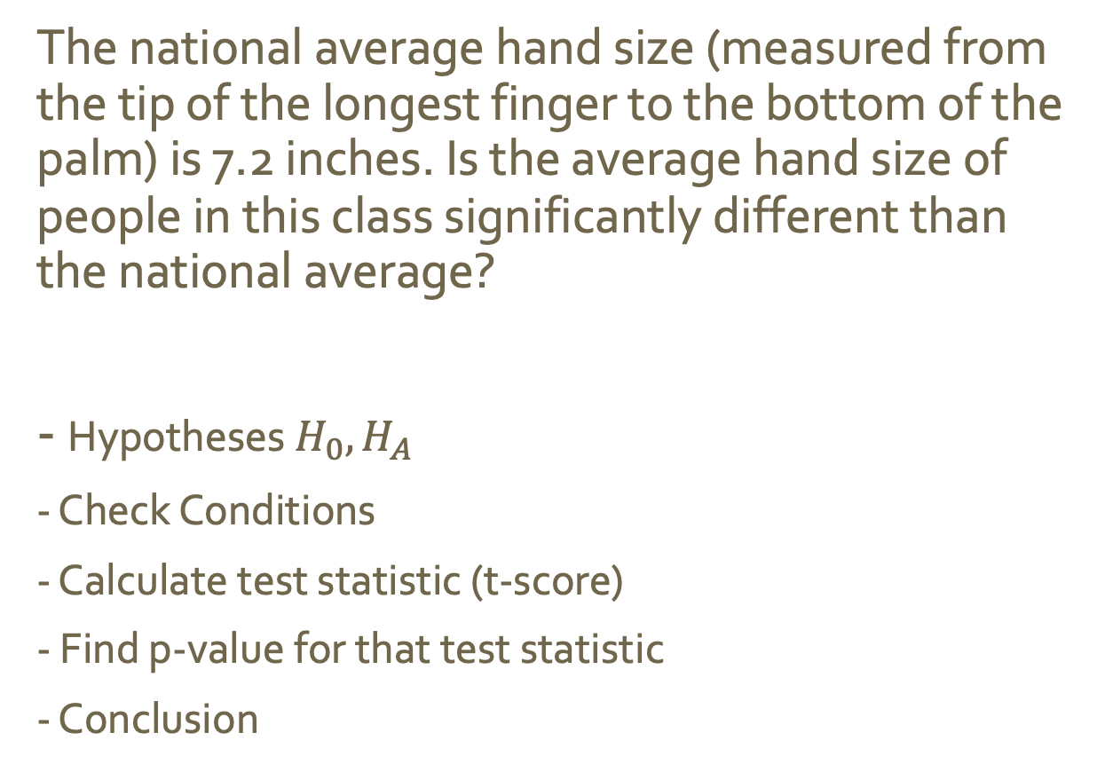
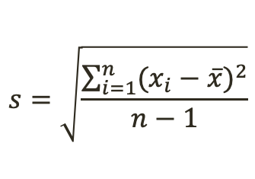
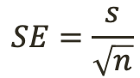
(Throwback) Practice Time
The national average hand size (measured from the tip of the longest finger to the bottom of the palm) is 7.2 inches. Is the average hand size of people in this class significantly different than the national average?
- Hypotheses $H_{0}, H_{A}$
- Check Conditions
- Calculate test statistic (t-score)
- Find p-value for that test statistic
- Conclusion
$$T= \frac{obs −null}{SE}$$
$$df=n −1$$
$$SE=\frac{s}{\sqrt{n}}$$
$$s=\sqrt{\frac{\sum_{i=1}^{n}{{(x_{i}−\overline{x})}^{2}}}{n−1}}$$

